Slide 1


BLE Indoor location Analysis
By: Jiaju Shi
此相片 (作者: 未知的作者) 已透過 CC BY-SA 授權

Slide 2

Introduction Of IOT:
With the continuous development of science and technology, the innovation of 5G technology and the application of big data provide a better platform for us to realize high-technology such as the Internet of Things, smart cities and intelligent transportation.
The Internet of Things (IoT) is based on connectivity, with data as the core, interconnecting many devices to continuously promote the digital and intelligent development of all walks of life around the world, and is becoming a part of our social life.
此相片 (作者: 未知的作者) 已透過 CC BY 授權

Slide 3




IoT Applications
1. IoT Shopping Mall
2. IoT Smart City
3. IoT Communication
4. IoT Hospital

Slide 4

What is BLE
BLE(Bluetooth Low Energy) is a personal LAN technology designed by the Bluetooth SIG for use in emerging applications in healthcare, sports and fitness, beacons, security, home entertainment and more. Compared to classic Bluetooth, low-power Bluetooth is designed to maintain the same communication range while significantly reducing power consumption and cost.

Slide 5
BLE Versus Traditional Bluetooth
 | BLE | BT
Standard Protocol | Bluetooth Protocol 4.0 and above | Bluetooth Protocol 2.1-3.0
Radio Frequency | 2.4GHZ | 2.4GHZ
Transmission Distance | 100m | 10m
data transmission time | <3ms | 100 ms
Corresponding Time | 6ms | About 100ms
Data Transmission Rate | 1Mb/s | 1-3Mb/s
Power Consuming | 0.01-0.5W | 1W

Slide 6

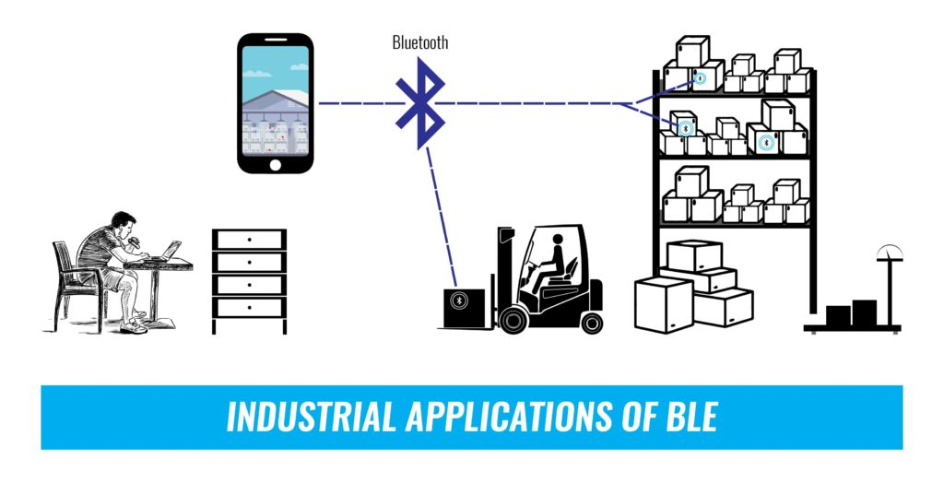
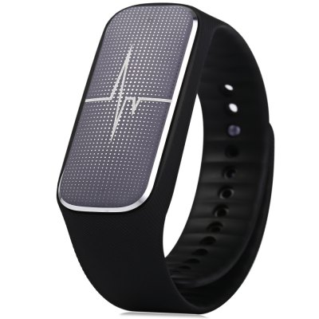
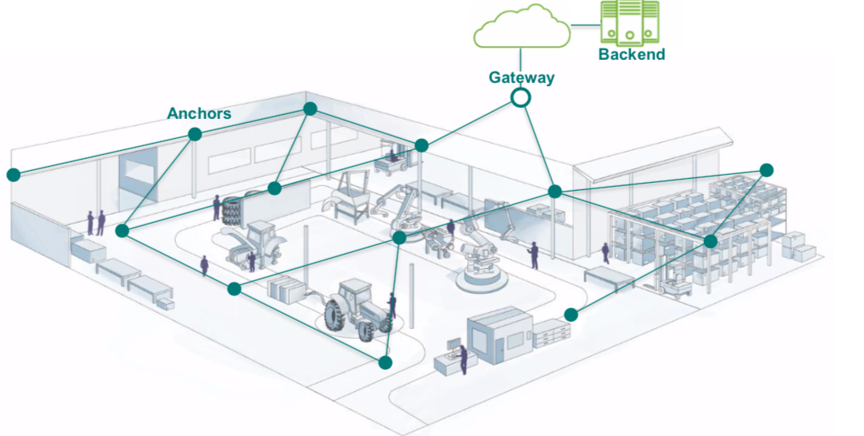
Applications for Bluetooth
Health Care
Sport and fitness
Internet connection
General sensors purpose
HID Connection
Proximity sensing
Batteries
Industrial Implications
BLE Light Control
Indoor Location
BLE Fitness

Slide 7
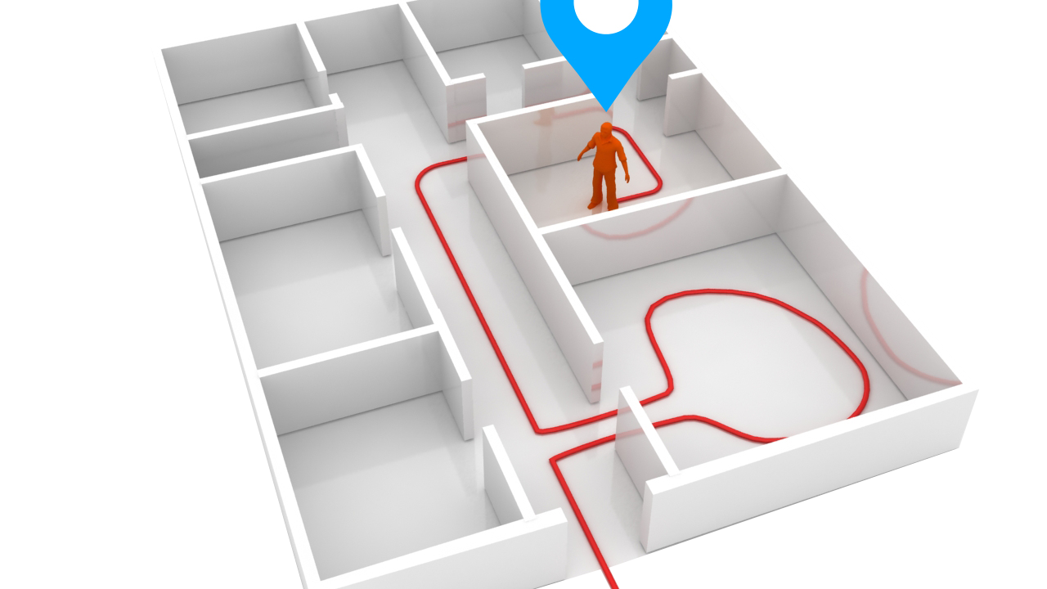
Positioning System
Positioning system is an interconnected collection or device constituted with the objective of determining a spatial location.
Specific functions such as navigation and positioning are performed by collecting information from observation points through different sensors.

Slide 8
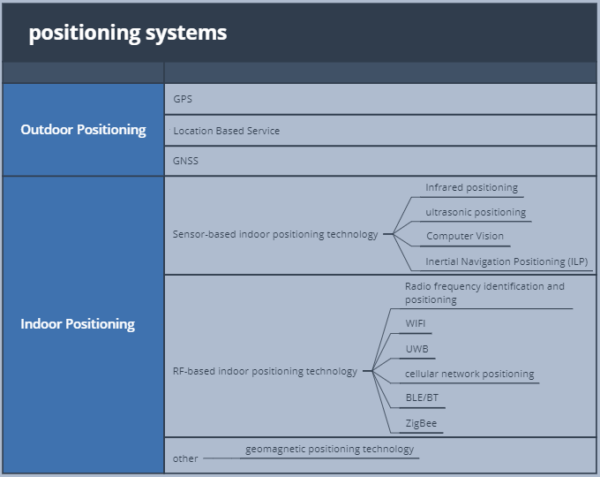
Common Positioning Systems

Slide 9
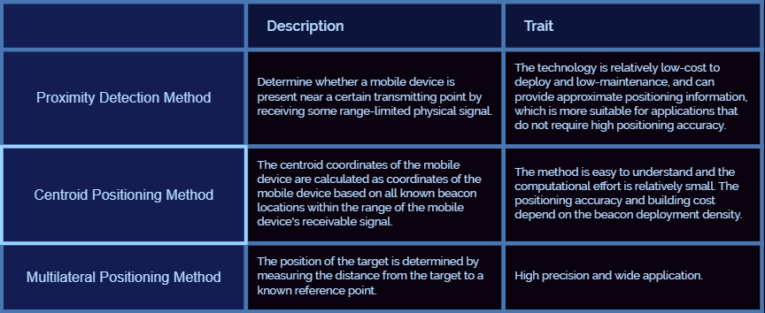
Common positioning methods for indoor positioning I

Slide 10
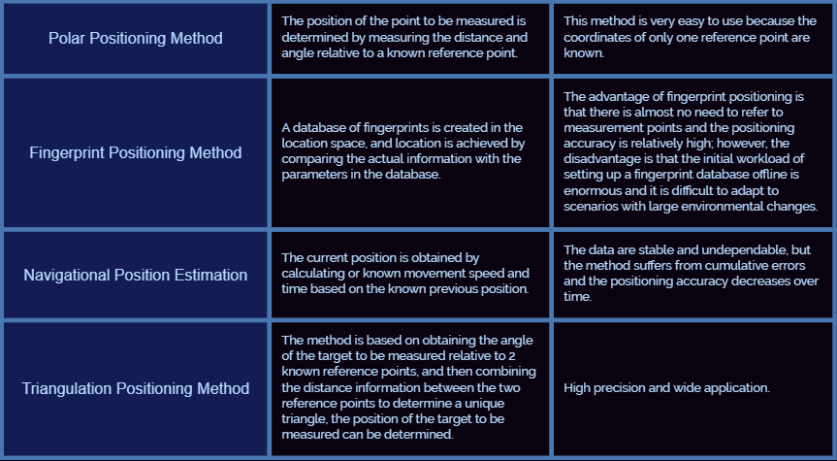
Common positioning methods for indoor positioning II

Slide 11

Challenges to indoor positioning
Indoor positioning is required to meet the following requirements:
1.Accuracy
2.Coverage
3.Reliability
4.Cost
5.Number scalability
6.Response time.
The requirements will vary greatly from case to case, so customization is required.

Slide 12
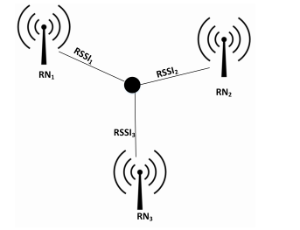


observation quantity: RSSI
RSSI is a received signal strength indicator, which is used to determine the quality of the link and whether the broadcast transmission strength has been increased.
By measuring the distance between the signal point and the receiving point based on the received signal strength, we can perform positioning calculations using RSSI.
$$p_{0}=R_{X}G_{t}G_{r}{\left(\frac{λ}{4π}\right)}^{2}$$
$$P_{r}=P_{0}−20\log_{10}{(d)}$$
Pr：Received Power;
Pt: Transmitted Power
Gt/Gr = transmitter and receiver antenna gains
P0: RSS in unit distance;
d: distance between transmitter and receiver
Lambda : = C/f : wavelength of the carrier

Slide 13
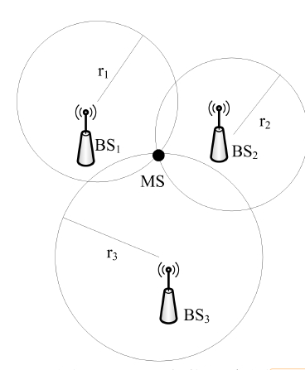

observation quantity: TOA
The TOA positioning method is based on measuring the arrival time of the received signal between the base station and the mobile station, and then converting it to distance.
TOA: $τ=\frac{φ}{2πfc}$=$\frac{2d}{c}$
This method requires a minimum of three base stations, and the estimated location of the target can generally be calculated using the least squares method.

Slide 14
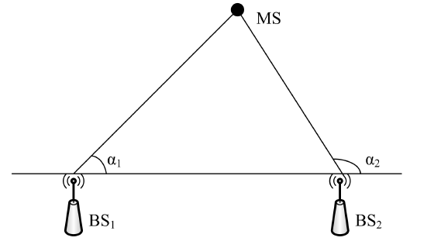

observation quantity: AOA
It measures the angle of arrival between the mobile station and the base station and estimates the position of the target by calculating the intersection of the two rays.
$$\tan{a_{1}=\frac{y−y_{i}}{x−x_{i}}}$$

Slide 15
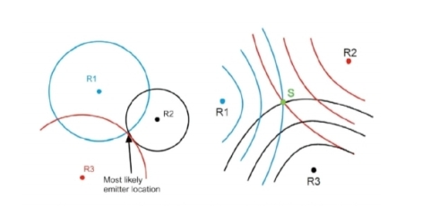
observation quantity: DTOA
TDOA is a method of locating using time differences, where the distance to a signal source can be determined by measuring the time it takes for the signal to reach a monitoring station.
By using the distance of the signal source to multiple radio monitoring stations, the location of the signal can be determined.
By comparing the time difference between the signal's arrival at multiple monitoring stations, a hyperbola can be made with the monitoring station as the focal point and the distance difference as the long axis, and the intersection of the hyperbola is the signal's position

Slide 16

Data Analysis
此相片 (作者: 未知的作者) 已透過 CC BY-ND 授權

Slide 17
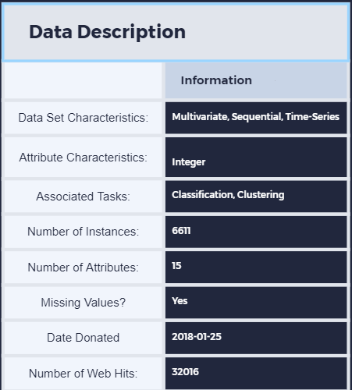
Data descriptions
NAME : BLE RSSI Dataset for Indoor Localization and Navigation Data Set
Source From: Machine Learning Repository
Data Set Info: The dataset was created using the RSSI readings of an array of 13 ibeacons in the first floor of Waldo Library, Western Michigan University.
Device : iPhone 6S
The input data contains the location (label column), a timestamp, followed by RSSI readings of 13 iBeacons.
RSSI measurements are negative values. Bigger RSSI values indicate closer proximity to a given iBeacon (e.g., RSSI of -65 represent a closer distance to a given iBeacon compared to RSSI of -85). For out-of-range iBeacons, the RSSI is indicated by -200.
The locations related to RSSI readings are combined in one column consisting a letter for the column and a number for the row of the position. The attached figure depicts the layout of the iBeacons as well as the arrange of locations.
@article{mohammadi2017semi, author={M. Mohammadi and A. Al-Fuqaha and M. Guizani and J. S. Oh}, journal={IEEE Internet of Things Journal}, title={{Semi-supervised Deep Reinforcement Learning in Support of IoT and Smart City Services}},year={2017},pages={1-12},publisher={IEEE},doi={10.1109/JIOT.2017.2712560},ISSN={2327-4662},}

Slide 18
concrete procedure
1. Step one: Data Preprocessing:
Determination of missing values, Remove the missing value, Removal of duplicate information, Revision data content, Correlation verification.
2. Apply Different Machine Learning Algorithm, with different Data fragmentation methods
3. Calculate the accuracy of each model.
4. Visualized result

Slide 19
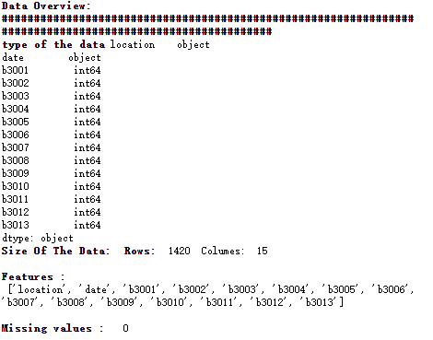
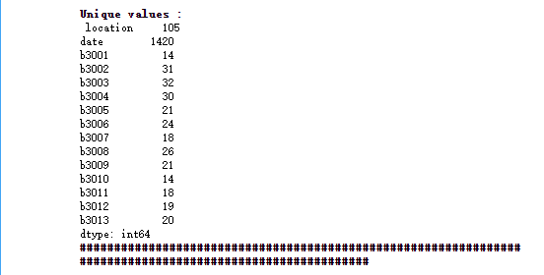
Data Overviews

Slide 20
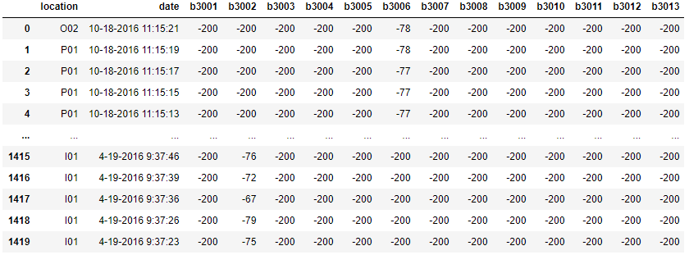
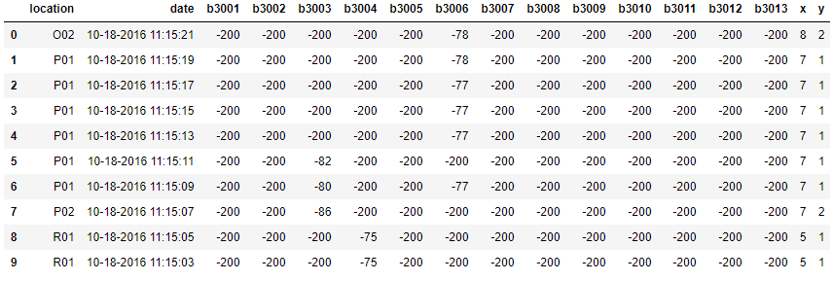
Data preprocessing
Before Preprocessing
After Preprocessing
The location of the original data is composed of English letters and Arabic numerals to form a string, which represents the x and y coordinates of the current location, so it is necessary to use ASCII to recompile the English letters into Arabic numerals and add them back into the data.

Slide 21
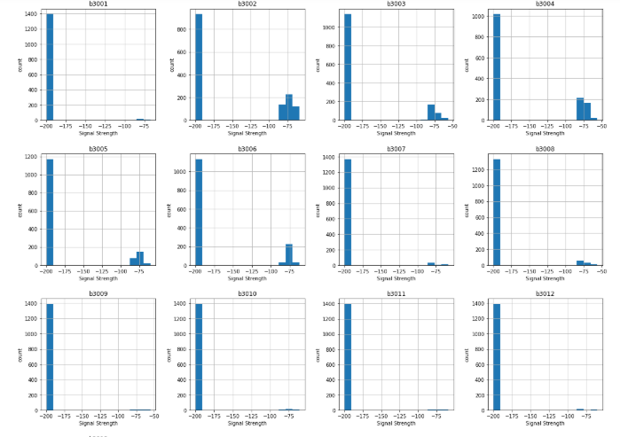
RSSI Count
The number in the image on the left shows the RSSI count number for each data item.
As we know, -200dB means that the iBeacon is not receiving any signal from the target location. If it is greater than -200dB, it means iBeacon can receive the location information of the target, and the larger the RSSI data, the closer the actual distance to the target.
Therefore, we cannot calculate the outlier by IQR, which leads us to keep all the outliers in the experiment.

Slide 22
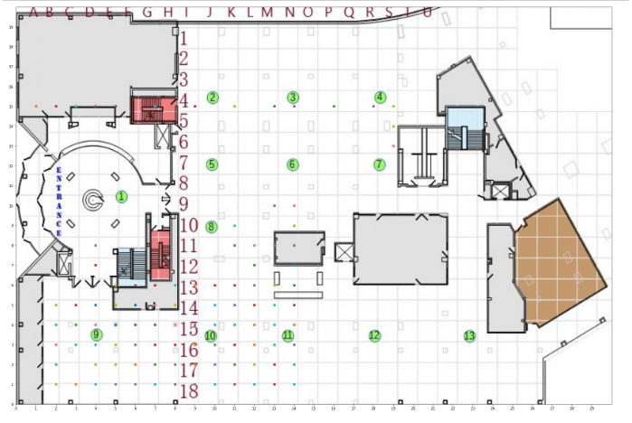
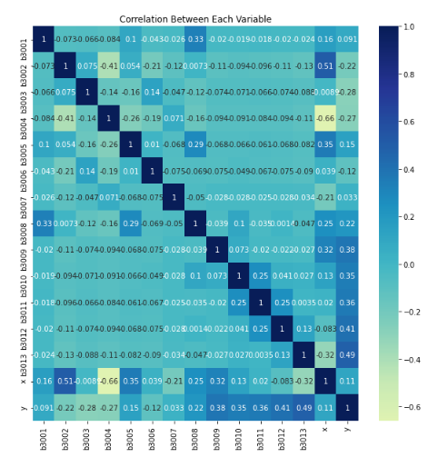
Pictured at left is the first floor of the Waldo Library. Each point indicates the approximate location of this current location, Arabic numerals indicate the horizontal coordinates of the library, and the letters indicate the vertical coordinates. We have already converted the vertical coordinates in ASCII form.
The right figure shows the correlation between each beacon.

Slide 23
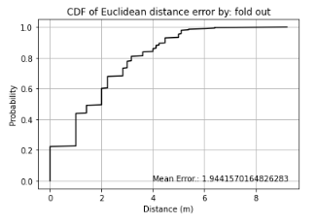
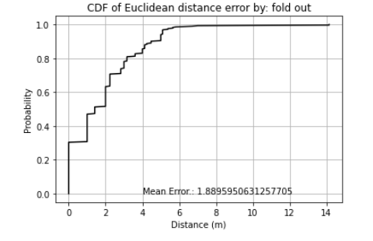
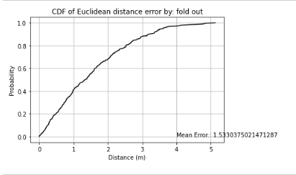
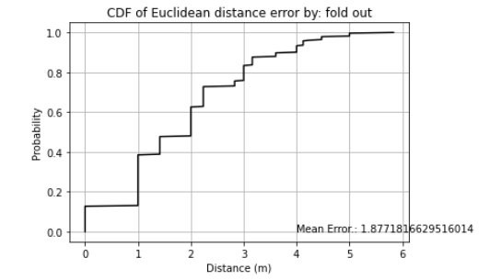
Algorithm accuracy Comparison by foldout Method
KNN
XGBoost
Random Forest
SVM
Initially, we hoped to be able to calculate ROC curves to determine the accuracy of the data model but found that ROC could not support multi-label data. So we started to calculate the Euclidean distance difference between the prediction set and the test set to analyze the accuracy of the model.

Slide 24
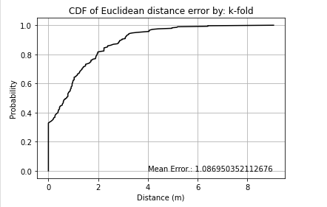
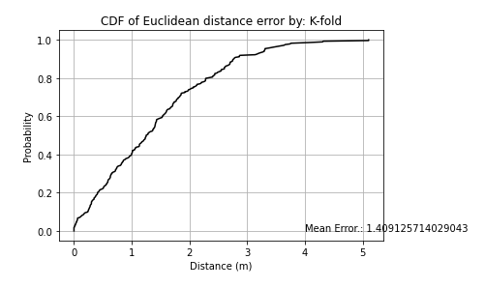
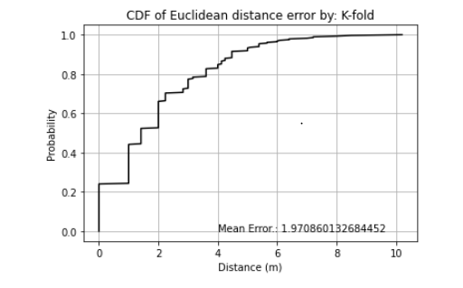
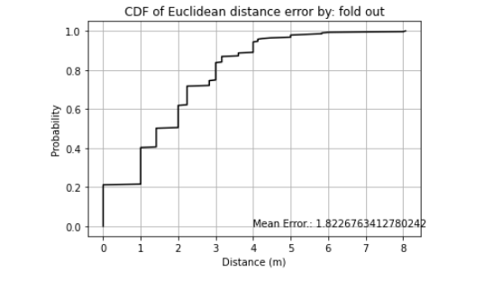
Algorithm accuracy Comparison by K-fold Method
KNN
SVM
XGBOOST
Random Forest
Machine learning algorithms such as SVM and XGBOOST can only fit one-dimensional parameters,
so MultiOutputRegressor() is needed to increase the dimensionality of the fitted parameters.

Slide 25
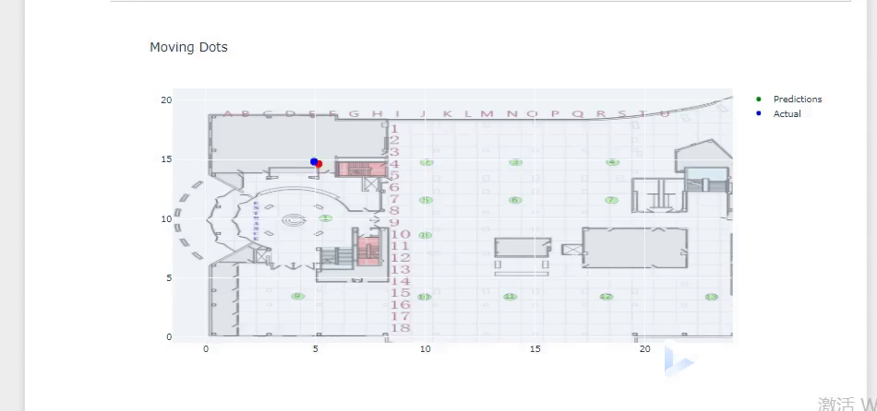
Demonstration by Knn

Slide 26
How to improve?
1. Standardized the dataset.
2. Construct more features by known features
A. We can use the Euclidean distance to measure the distance from the actual point to the coordinate origin. This gives us the features of the Euclidean distance.
B. In addition to the Euclidean distance, we can also calculate the angle from the predicted point to the origin.
3. Calculate model accuracy by ‘explained variance score’and ‘R^2 score’

Slide 27
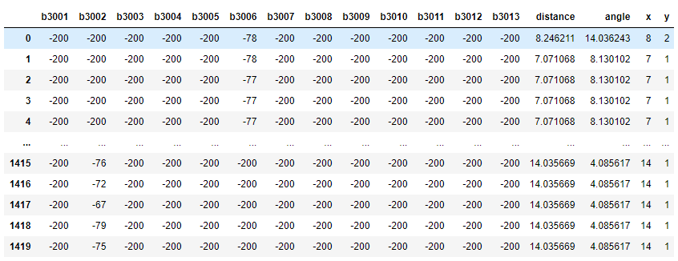
Data after improvement

Slide 28
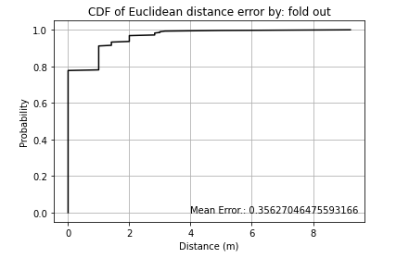
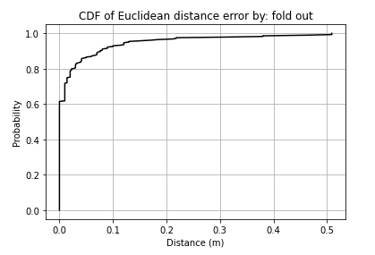
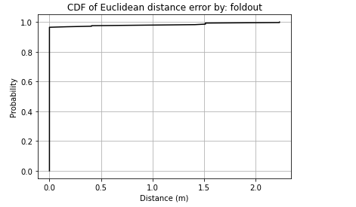
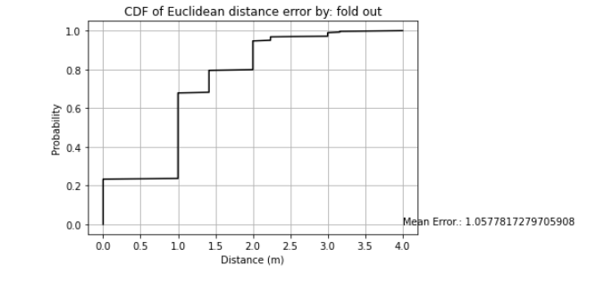
Accuracy Improvement by :Fold out
KNN
SVM
Random Forest
XGBoost

Slide 29
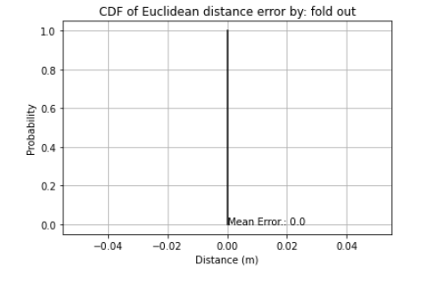
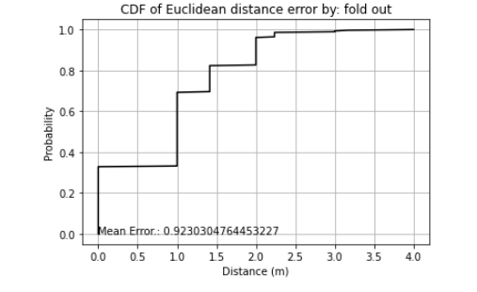
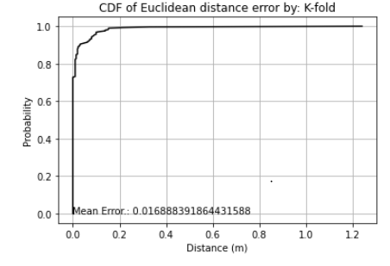
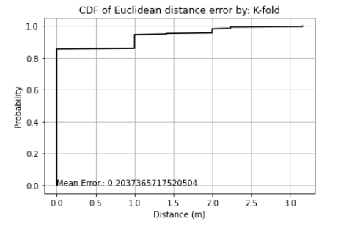
Accuracy Improvement by :K-Fold
XGBOOST
SVM
Random Forest
KNN

Slide 30
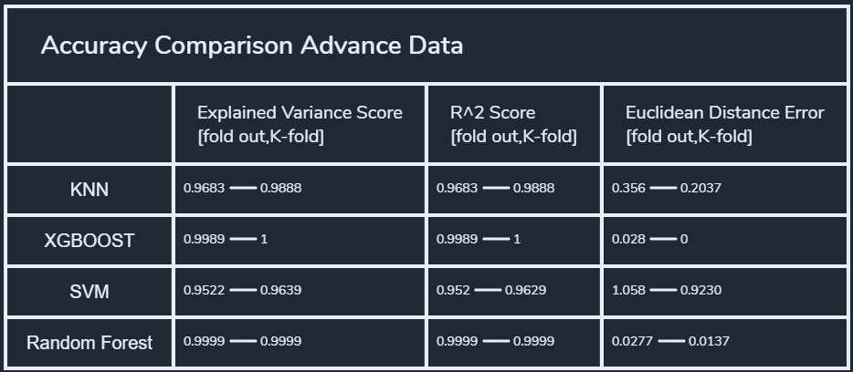
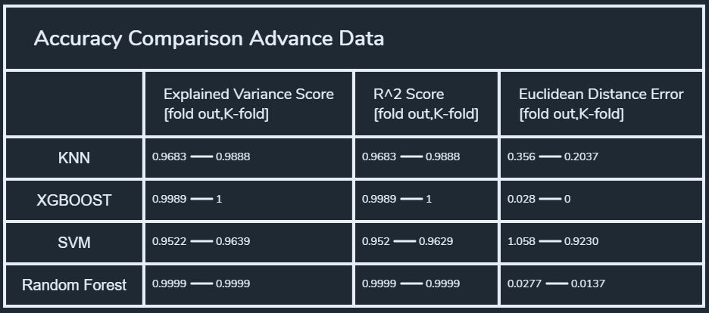
Accuracy Comparison
The above image shows the accuracy of different machine learning algorithms, in different data, in different slicing methods.
The most accurate fingerprint location algorithm we can find is through the XGBOOST data model.

Slide 31
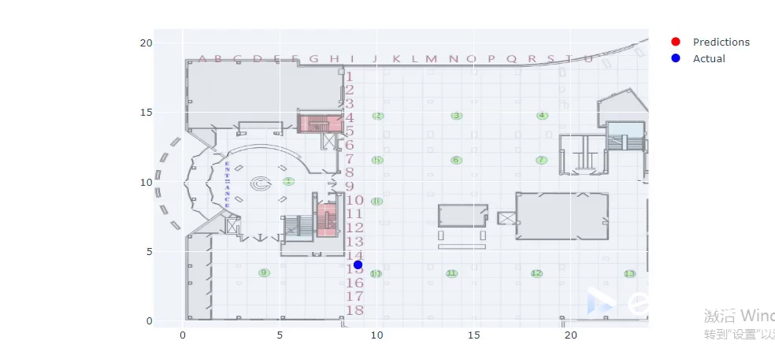
Demonstration II

Slide 32
Conclusion & Future Improvement
The project was very interesting, and by analyzing and processing the dataset we can clearly see that the algorithm is progressing.
In the course of my work, I encountered many problems that I had never encountered before, such as Mutli-labels and how to calculate Accuracy with multi-labels.
Compared with Jupyter Notebook, the performance of data on Databricks is not obvious, probably because the number of datasets is not big enough and the feature is relatively simple. Compared with DataBricks, Jupyter Notebook is more intuitive and more convenient for mapping. Therefore, the project is presented in the form of a Jupyter Notebook.
In the future, I hope to find more raw data. By performing signal processing on the raw signals, this will allow for a more detailed analysis of the BLE. It will also be possible to understand more about the BLE localization algorithm.

Slide 33


